Slide 1

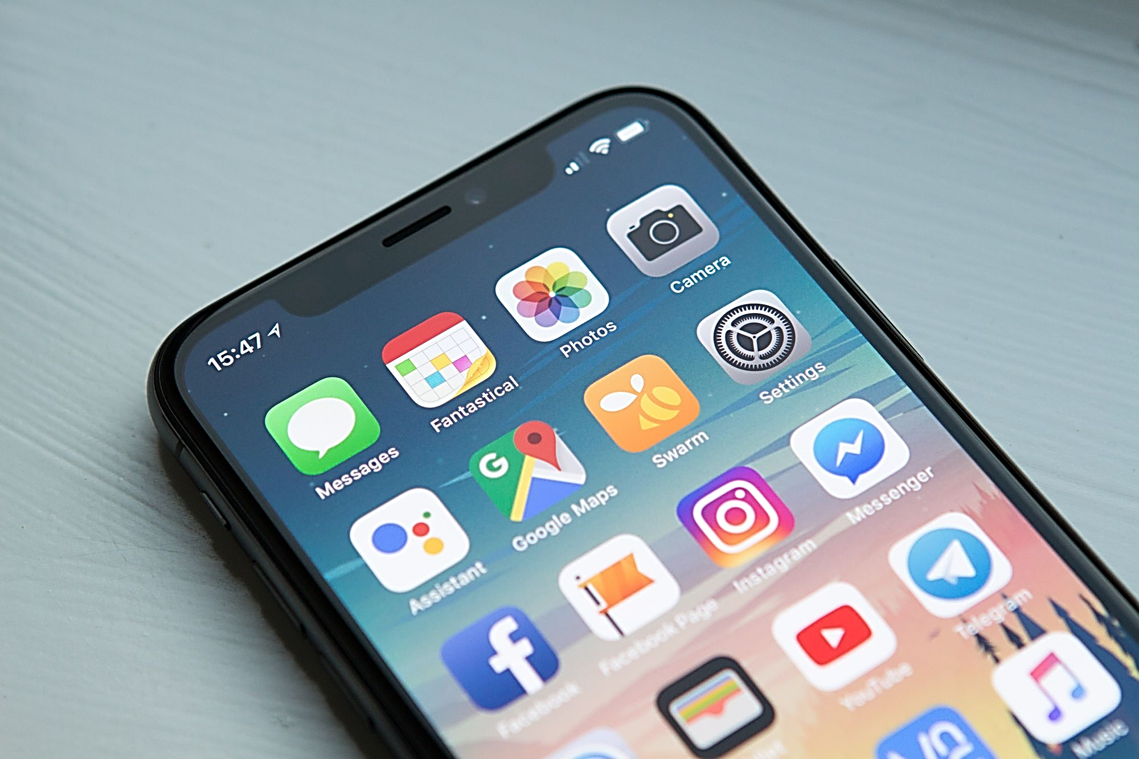


Mobile Apps Programming
P E D Putra, M.Si.
Lecture 1 - Introduction

Slide 2
Course Outline & Details
Course | : | Mobile Apps Programming
Time | : | Thursday 19.00 pm – 20.45 pm
Room |  | Lab 2
Instructor/ Lecturer | : | P E D Putra, M. Si. M. Eng. https://www.linkedin.com/in/p-e-d-putra-7802a5104/ https://research-pedputra.github.io/main/index.html
Assessment | : | Attendance, Full
 |  | Assignment (paper + presentation), 20 %
 |  | Mid-Sem (UTS), 30 % - Theory
 |  | Final-Sem (UAS), 50 % - Post Project
 |  | Additional rules, skip-class means -5 from final score*
Lecture |  | 70 % Practice + 30 % Theory

Slide 3
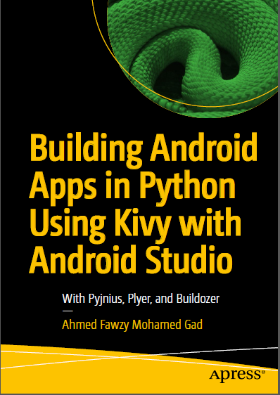
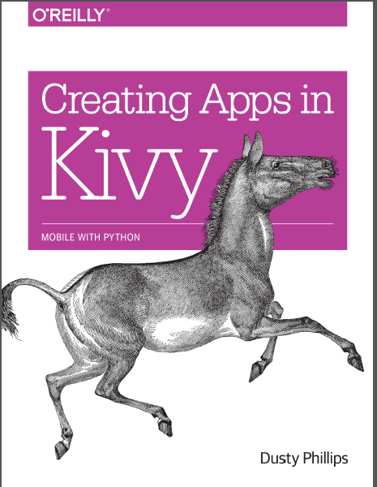
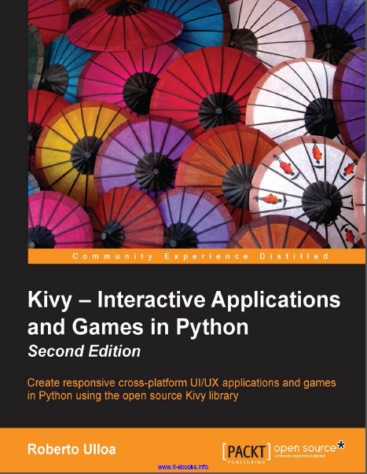
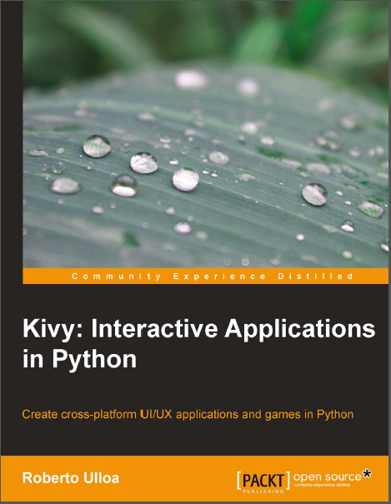

Resources
All the e-book is stored and shared via

Slide 4
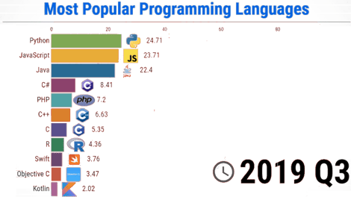
What is Language Programming?
A programming language is a way of communicating with computers using a set of instructions written in a specific syntax
Types of Language Programming:
Python
Known for its simplicity and readability, Python is a versatile language used in web development, data analysis, artificial intelligence, and more.
JAVA
A widely used language known for its platform independence, making it suitable for developing applications that run on various operating systems.
C++
A powerful and versatile language often used in system software, game development, and high-performance applications.
People choose Language Programing based on their needs, functionality, and readability

Slide 5





What is Mobile Apps?
Types of Apps:
Desktop Apps
Built for computers with mouse and keyboard interactions.
Mobile Apps
Designed for smartphones and touch inputs.
Web Apps
rowser-based programs
A mobile app is a type of software application that is designed to run on mobile devices and serves as an extension to a desktop software application or a website.
Example to mobile apps, the topmost functionality

Slide 6
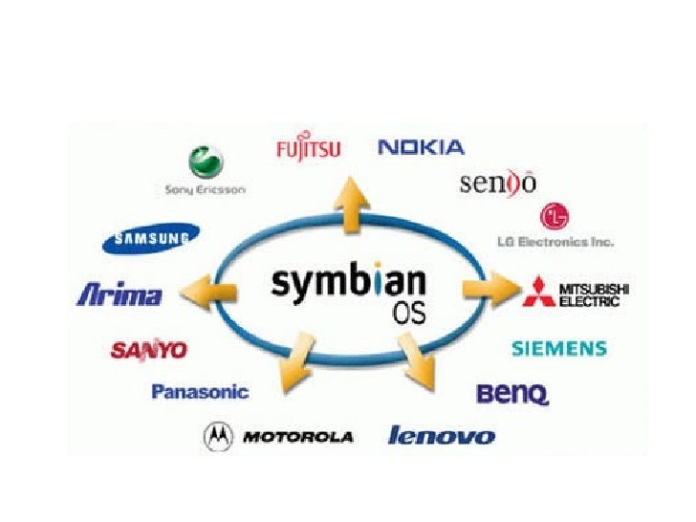
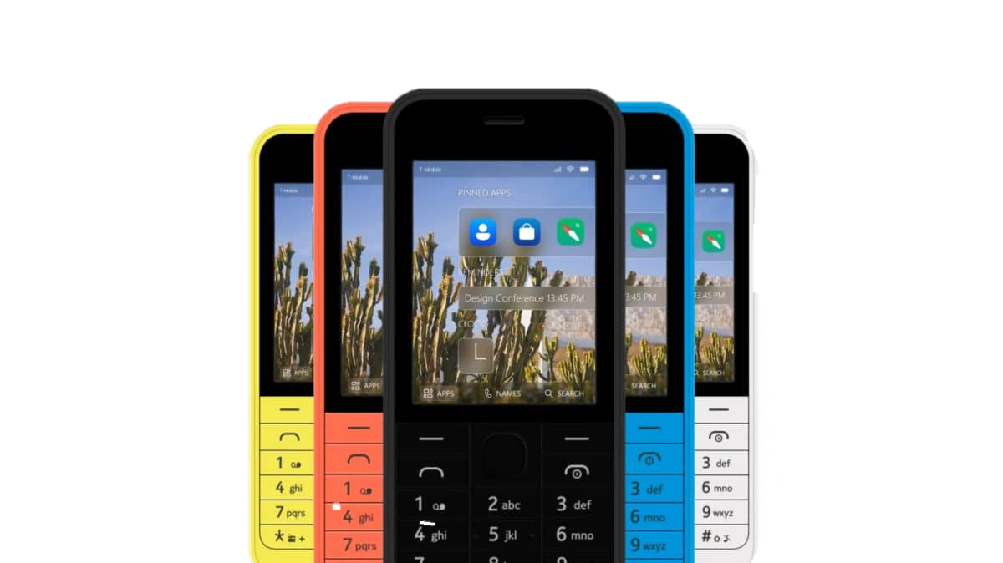
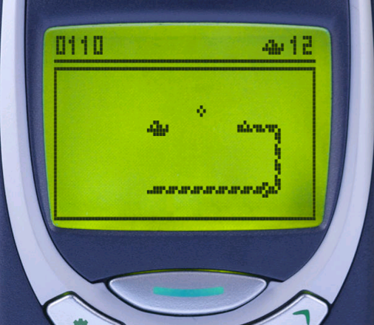

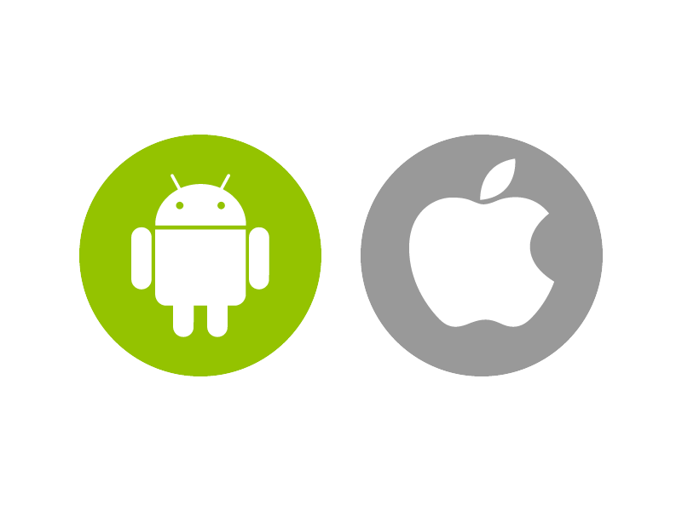

History of Mobile Apps
Snake game in Nokia phone
Symbian OS
Developed more and more
Example to mobile apps, the topmost functionality

Slide 7
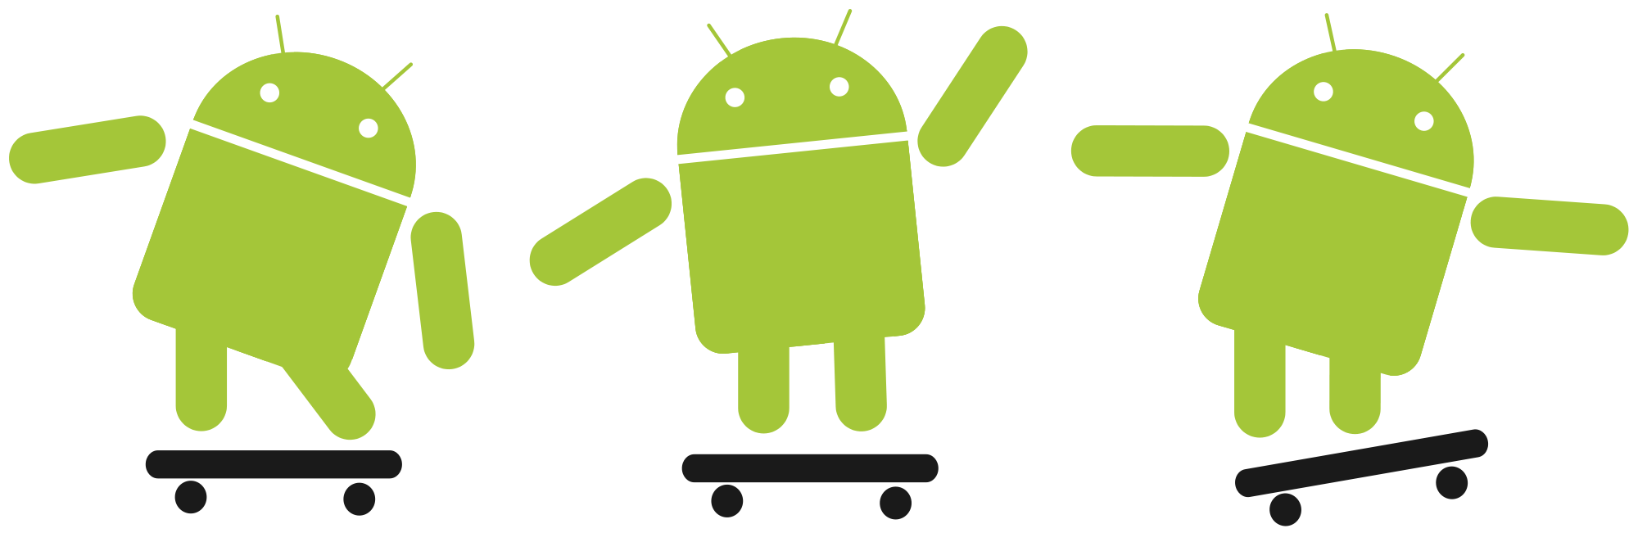
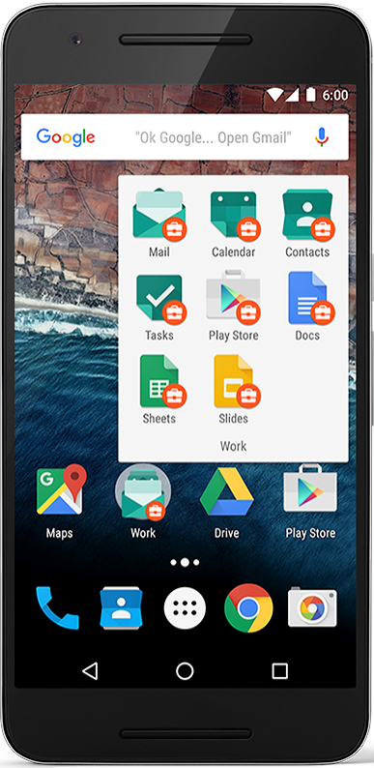
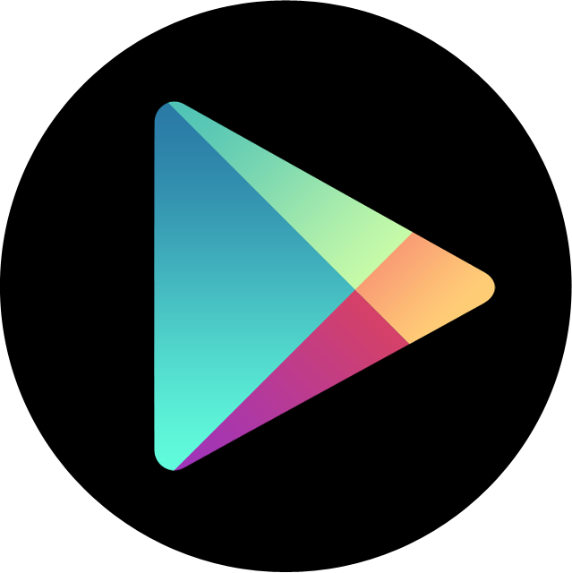
Androids and Its Development
Mobile operating system based on Linux kernel
User Interface for touch screens
Used on over 80% of all smartphones
Highly customizable for devices / by vendors
Open source
Publish apps through Google Play store:
Official app store for Android
Digital distribution service operated by Google

Slide 8
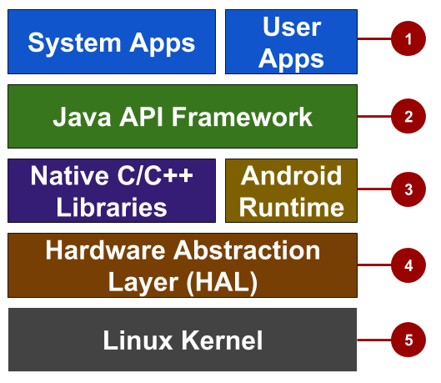
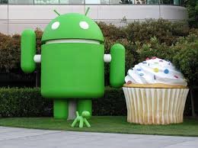
Androids and Its Development
Architectures
System and user apps
Android OS API in Java framework
Expose native APIs; run apps
Expose device hardware capabilities
Linux Kernel
System apps have no special status
System apps provide key capabilities to app developers

Slide 9
Androids and Its Development
Architectures
System and user apps
Android OS API in Java framework
Expose native APIs; run apps
Expose device hardware capabilities
Linux Kernel
System apps have no special status
System apps provide key capabilities to app developers

Slide 10
Androids and Its Development
Architectures
System and user apps
Android OS API in Java framework
Expose native APIs; run apps
Expose device hardware capabilities
Linux Kernel
The entire feature-set of the Android OS is available to you through APIs written in the Java language.
View class hierarchy to create UI screens
Notification manager
Activity manager for life cycles and navigation
Application Programming Interface (API)

Slide 11
Androids and Its Development
Architectures
System and user apps
Android OS API in Java framework
Expose native APIs; run apps
Expose device hardware capabilities
Linux Kernel
Each app runs in its own process with its own instance of the Android Runtime.
Core C/C++ Libraries give access to core native Android system components and services.
HAL: Standard interfaces that expose device hardware capabilities as libraries

Slide 12
Androids and Its Development
Architectures
System and user apps
Android OS API in Java framework
Expose native APIs; run apps
Expose device hardware capabilities
Linux Kernel
Each app runs in its own process with its own instance of the Android Runtime.
Core C/C++ Libraries give access to core native Android system components and services.
HAL: Standard interfaces that expose device hardware capabilities as libraries
LINUX-Kernel

Slide 13
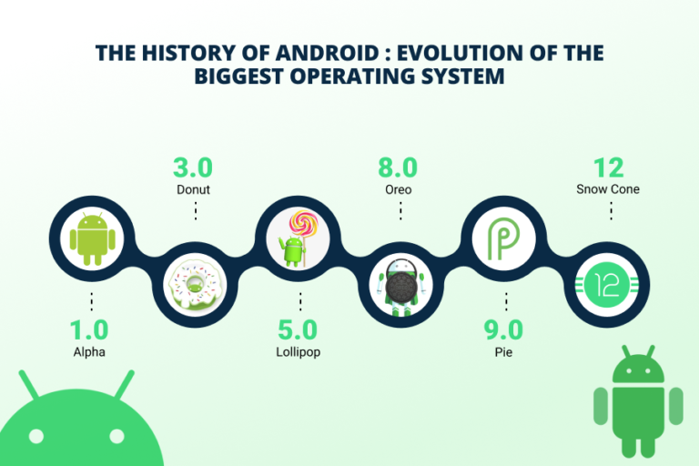
Androids and Its Development

Slide 14
IOS and Its Development
What is IOS?
Its an operating system of iPhone, a subset of Mac OS
Originally designed for iPhone, but now supports iPod touch, iPad, and Apple TV
iOS SDK is the software development kit (SDK) that allows application program to utilize classes and frameworks provided by SDK
The Integrated development environment (IDE) of Apple product called Xcode

Slide 15
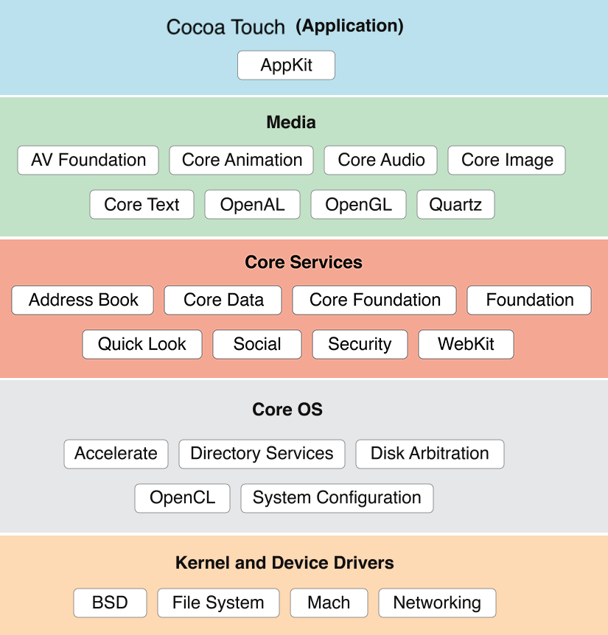
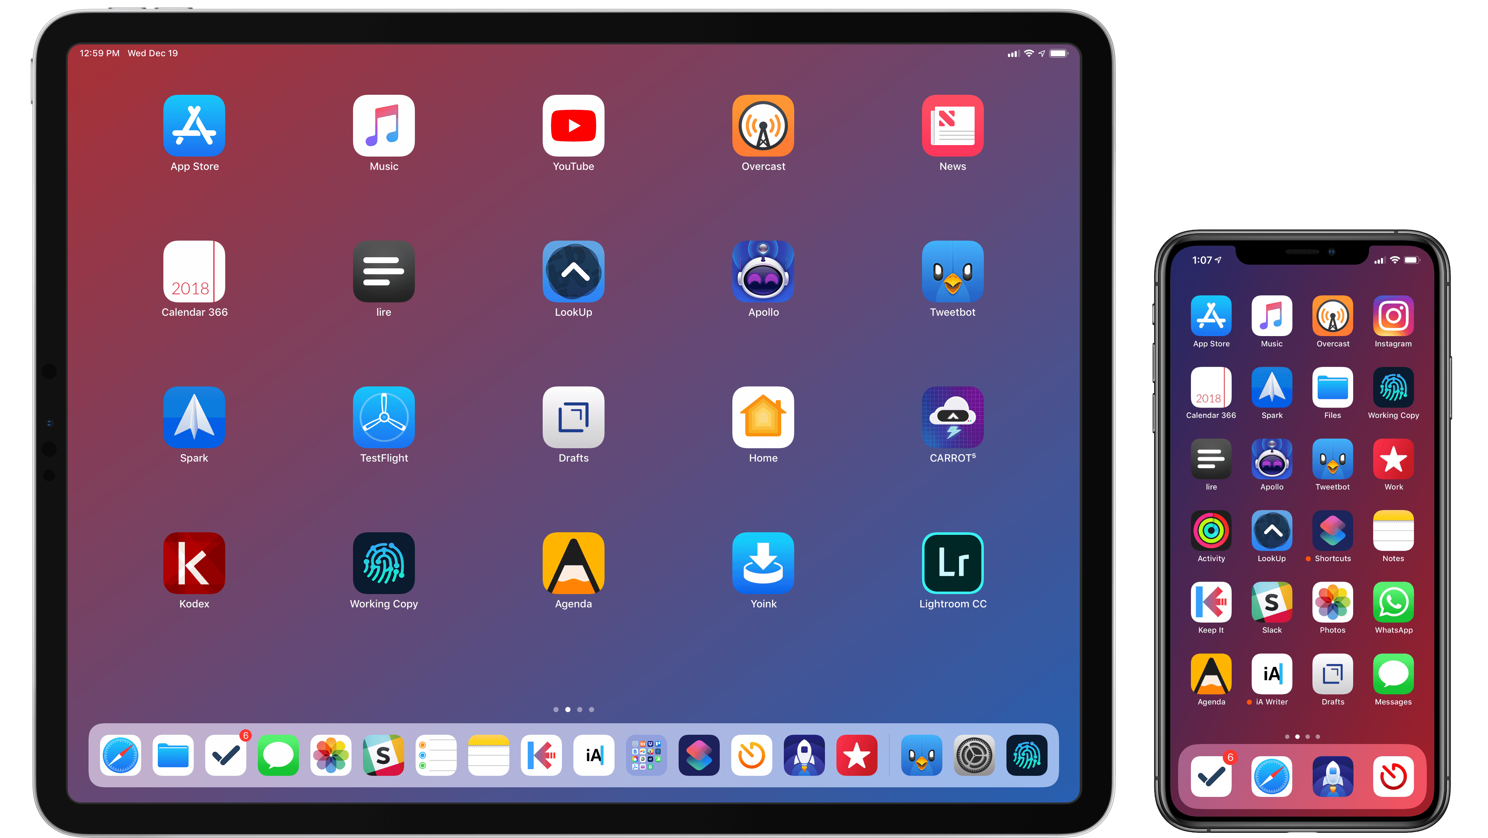
IOS and Its Development
iOS Architecture

Slide 16
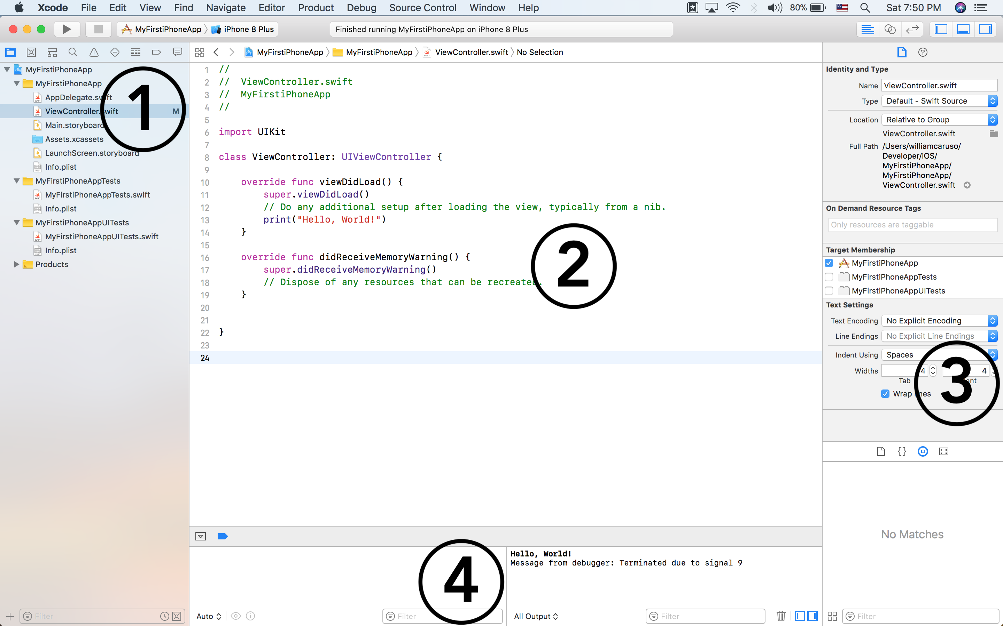
IOS and Its Development
Menu
Editor
Debugger
Utilities

Slide 17
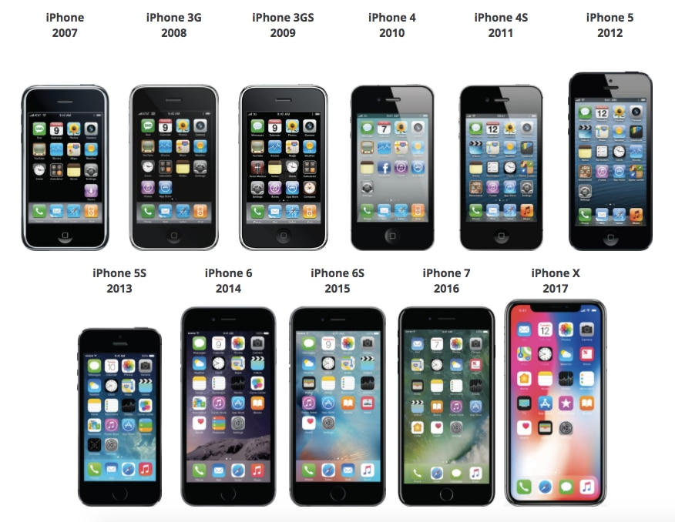
IOS and Its Development

Slide 18
Home Assignment (HW) - 01
Make a short report on the History of Androids and IOS developments.
Min 5 pages A4-paper, font TNR, 11, line space 1.5.
Deadline, 1 Week, No exception
Submit to the uploader link

